Slide 1

In statistics, variance refers to the spread of a data set. It’s a measurement used to identify how far each number in the data set is from the mean. A variance value of zero represents that all of the values within a data set are identical (same).
A large variance means that the numbers in a set are far from the mean and each other. A small variance means that the numbers are closer together in value.
Variance tells us how much a quantity varies w.r.t. its mean. Its the spread of data around the mean value. You only know the magnitude here, as in how much the data is spread.

Slide 2

Covariance provides insight into how two variables are related to one another. More precisely, covariance refers to the measure of how two random variables in a data set will change together.
A positive covariance means that the two variables at hand are positively related, and they move in the same direction
A negative covariance means that the variables are inversely related, or that they move in opposite directions.
Covariance tells us direction in which two quantities vary with each other.If 2 quantities have a positive covariance, they increase/decrease together.

Slide 3

Correlation shows us both, the direction and magnitude of how two quantities vary with each other. Correlation also informs about the degree to which the variables tend to move together
A correlation of +1 indicates a perfect positive correlation.
A correlation of -1 indicates a perfect negative correlation.
A correlation of 0 indicates that there is no relationship between the different variables (mass of a ball does not affect time taken to fall).
Values between -1 and 1 denote the strength of the correlation

Slide 4
The correlation coefficient is the term used to refer to the resulting correlation measurement. It will always maintain a value between one and negative one. When the correlation coefficient is +1, the variables under examination have a perfect positive correlation. In other words, when one moves, so does the other in the same direction, proportionally. If the correlation coefficient is <1, but still greater than zero, it indicates a less than perfect positive correlation. The closer the correlation coefficient gets to one, the stronger the correlation between the two variables. When the correlation coefficient is zero, it means that there is no identifiable relationship between the variables. If one variable moves, it’s impossible to make predictions about the movement of the other variable. If the correlation coefficient is -1, this means that the variables are perfectly negatively or inversely correlated. If one variable increases, the other will decrease at the same proportion. The variables will move in opposite directions from each other. If the correlation coefficient is >-1, it indicates that there is an imperfect negative correlation. As the correlation approaches negative one, the correlation grows.

Slide 5
Difference between Correlation and Correlation coefficient
Correlation is the process of studying the cause and effect relationship that exists between two variables.
Correlation coefficient is the measure of the correlation that exists between two variables.

Slide 6
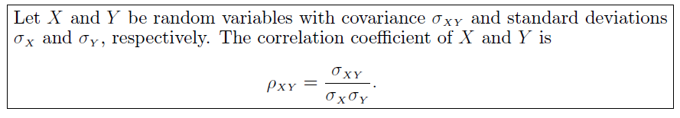
Correlation coefficient

Slide 7
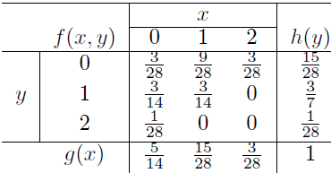





We wish to find the coefficient of correlation for

Slide 8




